Slide 1
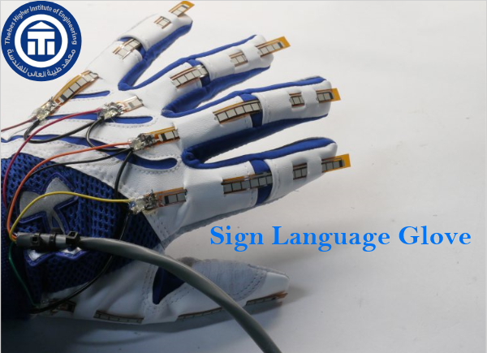

Slide 2
Content
General idea about the project
Connections
Hardware Components
Application
References
Future plan

Slide 3

General idea about the project
In view of the efforts of the countries of the world to help people with special needs and endeavor to support them in society in the best possible ways and facilitate their interaction with society and support it by all available means and starting from that the first goal of engineering sciences is to facilitate people's lives and achieve the welfare of societies, we offer this work to support those with special needs From deaf and dumb by facilitating their communication with society through a glove.

Slide 4
General idea about the project
It converts the sign language into a verbal language that is easy for all people to understand so that deaf and dumb can deal with all people without an obstacle of language that not all people can master but may be difficult for many of People to learn it.
Therefore, and as a contribution from us in this field, we offer this work, which we hope will be a real beginning to merge people with special needs from the deaf and dumb completely into society without any obstacles.

Slide 5
Hardware Components
ATmega32 Micro-controller
Flex Sensor
HC05 Bluetooth Module
Resistors
Capacitors
Regulator(5V)
Battery
Crystal Oscillator
Glove

Slide 6
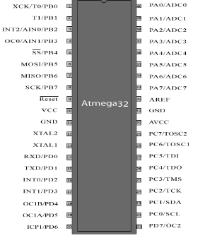
ATmega32 Micro-controller
ATmega32 is a low-power CMOS 8-bit microcontroller based on the AVR enhanced RISC architecture.
AVRs or all 8-bit microcontroller, meaning that the CPU can work on only 8 bits of data at a time. Data larger than 8bits has to be broken into 8bit pieces to be processed by the CPU.
AVRs are generally classified into four broad groups: Mega, Tiny, special purpose, and classic.

Slide 7
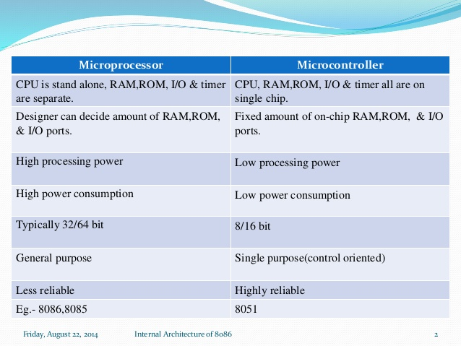
Microcontroller VS Microprocessor

Slide 8
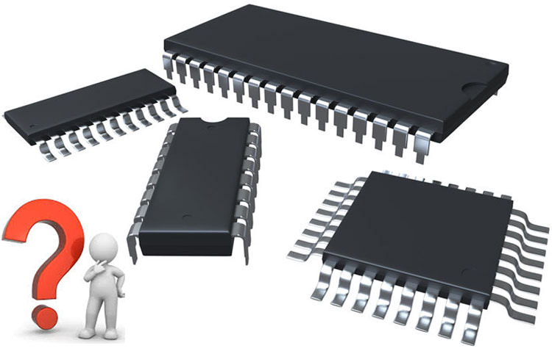
Criteria for choosing a microcontroller
1- It must meet the task at hand efficiently and cost effectively. In analyzing the needs of a microcontroller-based project, we must first see Whether an 8-bit, 16-bit, or 32-bit microcontroller can best handle the computing needs of the task most effectively. Among other considerations in this category are:
(a) speed what is the highest speed that the micro-controller supports?
(b) packaging Does it come in a DIP (duel inline package) or a QFP (quad flat package) this is important in terms of space, assembling, and prototyping the end product.
(c) power consumption is especially critical for battery powered products
(d) the amount of Ram and Rom on the chip.
(e) the number of I/O pins and the Timer on the chip.
(f) Ease of upgrade to higher- performance or lower- power- consumption versions.
(g) cost per unit. this is important in terms of the final cost of the product.

Slide 9
Criteria for choosing a microcontroller
2- how easy it is to develop products around it. key considerations include the availability of an assembler, a debugger, a code-efficient c language compiler, an emulator, technical support, and both in-house and outside expertise.
3- It's ready availability in needed quantities both now and in the future.

Slide 10
ATmega32 Features
High-performance, low power AVR 8-bit micro-controller
8-bit: meaning that the CPU can work on only 8-bit of data at time. Data larger than 8-bits has to be broken into 8-bit pieces to be processed by the CPU.
atmega32 is powerful, widely available, and comes in DIP packages.
speed grades: from 0 to 16 MHZ.
Power consumption at 1 MHz, 3V, 25C
- Active: 1.1 mA
- Ideal mode: 0.35 mA
- Power down mode: <1mA.
32K code ROM, 2K Data RAM, and 1K EEPROM.
32 I/O Pins and 8 ADC, and 3 timers and endurance: 1000 write/Erase cycles.
The AVR was one of the first micro-controllers to use on-chip Flash memory for program storage. The Flash memory is ideal for fast development because flash memory can be erased in seconds compared to 20 minutes or more needed for the UV-EPROM.
The cost is 55 EGP.
Advanced RISC Architecture (reduced instruction set computer).

Slide 11
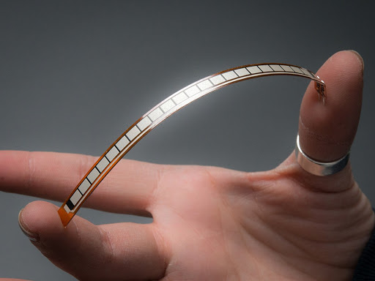
FLEX SENSOR
Flex sensor is a two-terminal device. The Flex sensor does not have polarized terminals like diode. So there is no positive and negative.
As the sensor is flexed, the resistance across the sensor increases.
Pin Configuration
Pin Number | Description
P1 | Usually connected to positive of power source.
P2 | Usually connected to ground.

Slide 12
FLEX SENSOR Features and Specifications
Operating voltage of FLEX SENSOR: 0-5 V
Can operate on LOW voltages
Power rating: 0.5Watt (continuous), 1 Watt (peak)
Operating temperature: -45ºC to +80ºC
Resistance Tolerance: ±30%
Bend Resistance Range: 45K to 125K Ohms (depending on bend)

Slide 13
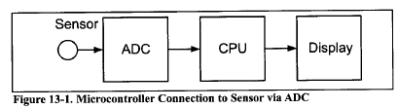
ADC device
Analog _ to_ digital converters are among the most widely used devices for data acquisition .
Digital computers use binary (discrete) values , but in the physical world everything is analog (continuous) . Temperature , pressure (wind or liquid) , humidity , and velocity are a few examples of physical quantities that we deal with every day .
A physical quantity is converted to electrical (voltage , current ) signals using a device called a transducer . Transducer are also referred to as sensors . Sensors for temperature , velocity , pressure , light , and many other natural quantities produce an output that is voltage (or current ) .
Therefore , we need an analog _ to _ digital converter to translate the analog signals to digital numbers so that the microcontroller can read and process them .

Slide 14
Some of the major characteristics of the ADC :-
1- Resolution :
The ADC has n _ bit resolution , where n can be 8,10,12,16, or even 24bits Higher _ resolution ADCs provide a smaller step size .
2- conversion time:
Is the time it takes the ADC to convert the analog input to a digital (binary) number.
3- V ref :
is an input voltage used for the reference voltage .
V ref (V) | Vin Range (V) | Step Size (mv)
5.00 | 0 to 5 | 5/256 = 19.53
4.0 | 0 to 4 | 4/256 = 15.62
3.0 | 0 to 3 | 3/256 = 11.71
2.56 | 0 to 2.56 | 2.56 / 256 = 10
2.0 | 0 to 2 | 2 / 256 = 7.81
1.28 | 0 to 1.28 | 1.28 / 256 = 5
1 | 0 to 1 | 1 / 256 = 3.90

Slide 15
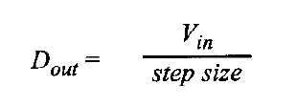
Digital Output
- In an 8-bit ADC we have an 8-bit digital data output of D0 _ D7, to calculate the output voltage, we use the following formula.
- D out = Vin / Step Size.
- D out is the digital data output (in decimal).
- Vin is the analog input voltage
- This data is brought out of the ADC chip either one bit at a time (serially), or in one chunk. using a parallel line of outputs.

Slide 16
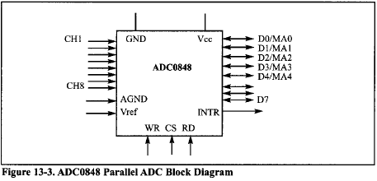
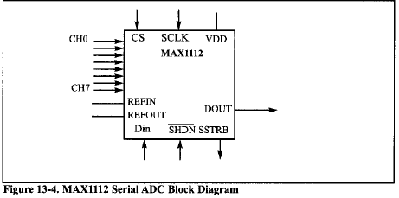
Types of ADC
1- Parallel ADC:-
- We have 8 or more pins dedicated to bringing out the binary data.
- The D0_D7 data pins of the 8 _ bit ADC provide an 8 _ bit parallel data path between the ADC chip and the CPU.
2-Serial ADC:-
- We have only one pin for data out, that means that inside the serial ADC, there is a parallel _ in _ serial _out shift register responsible for sending output the binary data one bit at a time.

Slide 17
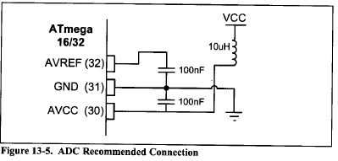
AVR ADC hardware considerations
- Decoupling AVCC from VCC:
-the AVCC pin provides the supply for analog ADC circuitry to get a better accuracy of AVR ADC we must provide a stable voltage source to the AVCC pin to achieve this, we provide ADC recommended connection.
Connecting a capacitor between V ref and GND:
By connecting a capacitor between the AVREF pin and GND you can make the V ref voltage more stable and increase the precision of ADC.

Slide 18
AVR programming
In the AVR micro controller five major register are associated with the ADC that we deal with in this project
The are ADCH (high data), ADCL (low data) ADCSRA (ADC control and status register), ADMUX (ADC multiplexer selection register ).

Slide 19
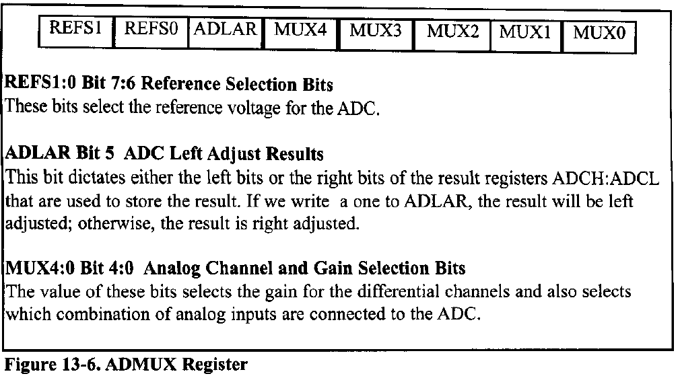
The first register is ADMUX
REFS1
REFS0
ADLAR
MUX4
MUX3
MUX2
MUX1
MUX0

Slide 20
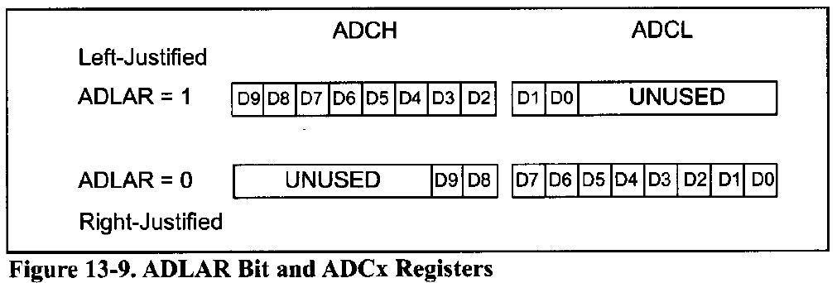
ADLAR BIT OPERATION
The AVR have a10-bit ADC, which means that the result is 10 bit long and cannot be stored in a single byte.
In AVR two 8-bit register are dedicated to the ADC result, but only 10 of the 16 bit are used and 6 bit are unused.
We can select the position of used bits in the bytes, if you set the ADLAR bit in ADMUX register, the result bit will be left-justified, otherwise, the result bits will be right –justified.

Slide 21
ADCH:ADCL Registers
- After the A/D conversion is complete, the result sits in register ADCL (A/D Result Low Byte) and ADCH (A/D Result High Byte).

Slide 22
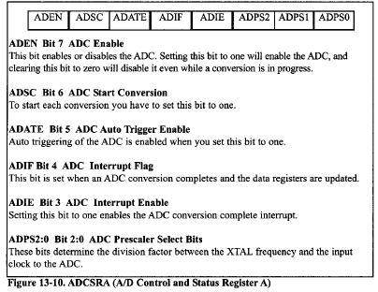
ADCSRA register
It is the status and control register of ADC bits of this register control or monitor the operation of the ADC.

Slide 23
Steps in programming the A\D converter
Make the pin for the selected of ADC channel an input pin
Turn on the ADC module of the AVR because it is disabled upon power on reset to save power
Select the conversion speed, we use register ADPS 2:0 to select the conversion speed.
Select voltage reference and ADC input channels.
Activate the start conversion bit by writing a one to the ADSC bit of ADCSRA.
Wait for the conversion to be completed by polling the ADIF bit in the ADCSRA register
After the ADIF bit has gone high read the ADCL and ADCH register to get the digital data output
If you want to read the select channel again, go back to step 5
If you want to select another V ref source or input channel, go back to step 4.

Slide 24
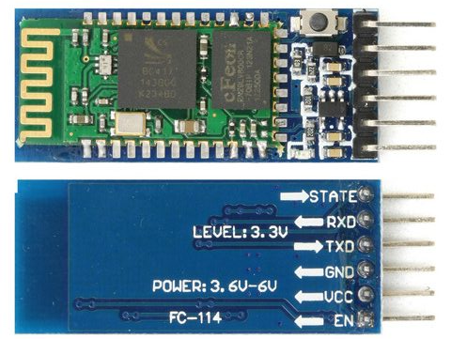
HC05 Bluetooth Module
You can use this module to communicate between two microcontrollers like Arduino or communicate with any device with Bluetooth functionality like a Phone or Laptop.
The module communicates with the help of USART at 9600 baud-rate hence it is easy to interface with any microcontroller that supports USART. We can also configure the default values of the module by using the command mode.
Works with Serial communication (USART)

Slide 25
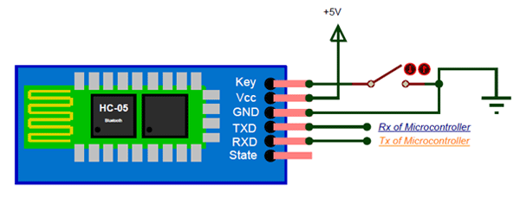
How to Use the HC-05 Bluetooth module
The HC-05 has two operating modes, one is the Data mode in which it can send and receive data from other Bluetooth devices and the other is the AT Command mode where the default device settings can be changed.
As soon as the module is powered you should be able to discover the Bluetooth device as “HC-05” then connect with it using the default password 1234 and start communicating with it. The name password and other default parameters can be changed.

Slide 26
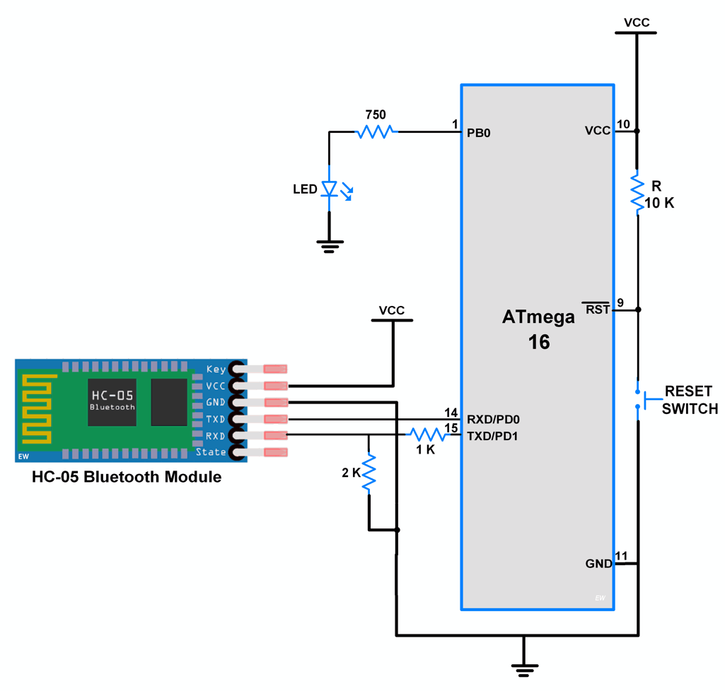
USART
The USART stands for universal synchronous and asynchronous receiver and transmitter.
This protocol is used for transmitting and receiving the data bit by bit(Serially).
The AVR microcontroller has two pins: TXD and RXD, which are specially used for transmitting and receiving the data serially.

Slide 27
Computers transfer data in two ways
Parallel:
-Data transfers often eight or more lines (wire conductors) are used to transfer data to a device that is only a few feet away.
- Devices that use parallel transfers include printers and IDE hard disk.
Serial:
- To transfer to a device located many meters away, the serial Method is used.
-The data is sent one bit at a time.

Slide 28
Serial Communication Methods
Synchronous:
-Transfers a block of data characters at a time
Asynchronous:
-Transfers a single byte at a time

Slide 29
Types of transmission
1- Simplex: (Computer only sends data)
2- Half duplex: (Data is transmitted one way at a time)
3- Full duplex:(The data can go both ways at the same time)
-Full-duplex requires two wire conductors for the data lines
(In addition to the signal ground), one for transmission and one for reception.

Slide 30
Asynchronous serial communication and data Framing.
-The data coming in a receiving end of the data line in a serial data transfer is all 0s and 1s.
-It's difficult to make sense of the data unless the sender and receiver agree on a set of rules, a protocol, on how the data is packed, how many bits constitute a character, and when the data begins and ends.

Slide 31
Data transfer rate
-The rate of data transfer in serial data communication is started in bps (bits per second) another widely used terminology for bps is Baud rate (the number of signal changes per second).

Slide 32
AVR serial port programming
-In the AVR micro-controller five registers are associated with the USART that we deal with in this project, They are:
(1) UDR (USART data register).
(2) UCSRA, UCSRB, UCSRC (USART control status register).
(3) UBRR (USART baud rate register).

Slide 33
UBRR register and baud rate in the AVR
-It is used for programming of the baud rate in the AVR.
- for a given crystal frequency the value loaded into UBRR decides the baud rate.
- The relation between the value loaded into UBRR and the FOSC (Frequency of oscillator connected to XTAL 1 and EXTAL 2 pines)
Is dictated by the following Formula:
Desired Baud rate = FOSC / ( b(x+1) ).
X »» Is the value we load into the UBRR register

Slide 34
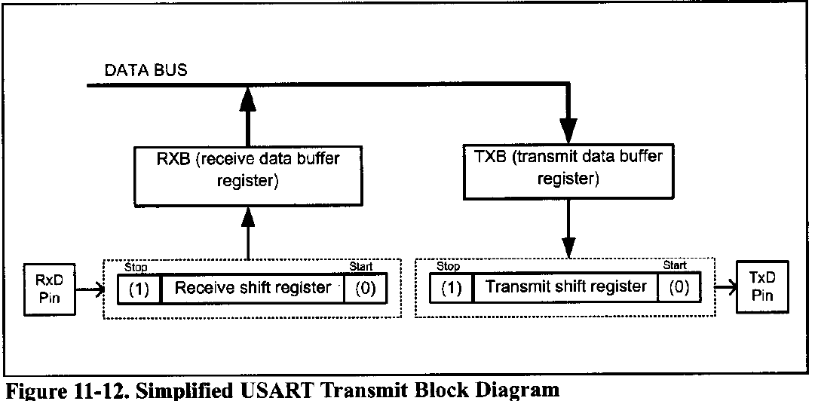
UDR registers and USART data I/O in the AVR
-The USART transmit data buffer register and USART receive data buffer register share the same I/O address, which is called USART data register or UDR.
-When you write data to UDR, it will be transferred to transmit data buffer register (TXB), And when you read data from UDR, it will return the contents of the receive data buffer register (RXB).

Slide 35
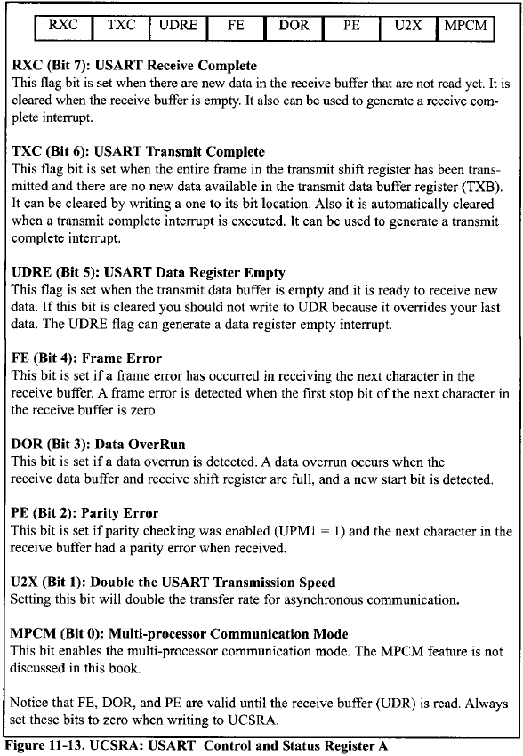
UCSRA Register and USART configurations in the AVR
-UCSRs are 8-bit control registers used for controlling serial communication in the AVR.
-There are three USART control status registers in the AVR.
(UCSRA, UCSRB, UCSRC).

Slide 36
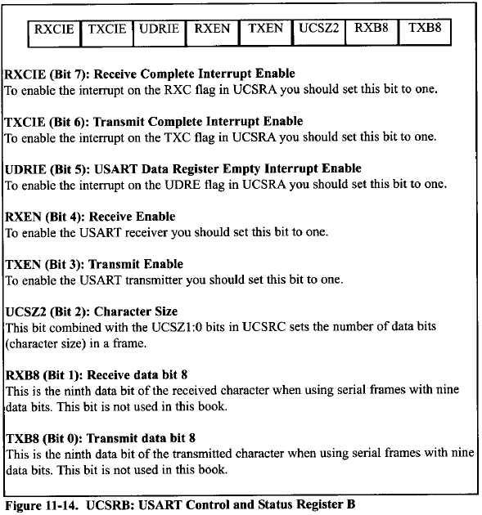
UCSRB Register and USART configurations in the AVR
-Three of the UCSRB register bits are related to interrupt.
-We monitor (poll) UDRE flag bit to make sure, That the transmit data buffer is empty and it is ready to receive new data, By the same logic, we monitor the RXC flag to see if a byte of data has come in yet.

Slide 37
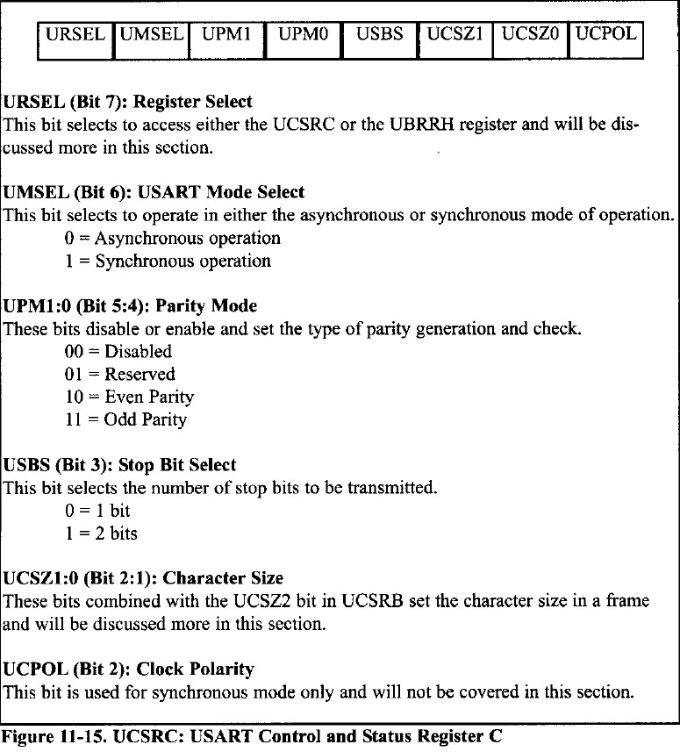
UCSRC Register and USART configurations in the AVR

Slide 38
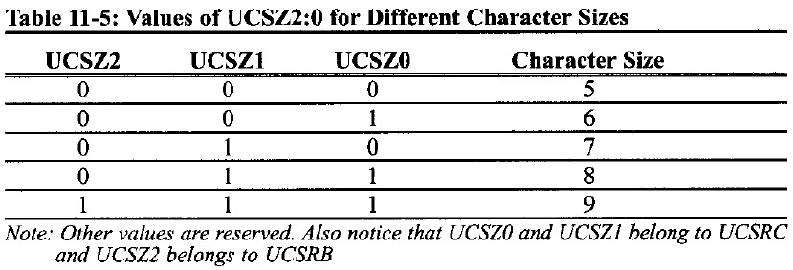
Determine character size
-To set the number of data bits (character size) in a frame you must set the value of the UCSZ1, UCSZ0 bits in the UCSRB and UCSZ2 bits in UCSRC.

Slide 39
Programming the AVR to transfer data serially
In programming the AVR to transfer character bytes serially, the following steps must be taken:
The UCSRB Register is loaded with the value 08H, Enabling the USART transmitter. the transmitter will override normal port operation for the TXD pin when enabled.
The UCSRC register is loaded with the value 06 h, Indicating a synchronous with 8-bit data frame, no parity, and one stop bit.
The UBRR is loaded with certain value to set the baud rate for serial data transfer.
The character byte to be transmitted serially is written into the UDR register.
Monitor the UDRE bit of the UCSRA register to make sure UDR is ready for the next byte.
To transmit the next to character, go to step4.

Slide 40


Application

Slide 41
Introduction
Sign To Speech is an Android app that receives a text by Bluetooth, displays this text, and says it.
To develop our app, we used the Java programming language, and Extensible Markup Language (XML) files to describe data resources.
To help you develop your apps efficiently, Google offers an integrated development environment (IDE) called Android Studio. It offers advanced features for developing, debugging, and packaging Android apps. Using Android Studio, you can develop for any Android-powered device, or create virtual devices that emulate any hardware configuration.
The minimum Android version is 4.0, which means it works in all current Android mobiles.
Our App APK size is 1.7MB.

Slide 42
XML
Android layouts are written in extensible Markup Language, also known as XML. Much like HTML (or Hypertext Markup Language), XML is also a markup language.
Android XML layouts are also part of a larger umbrella of Android files and components called resources. Resources are the additional files and static content an application needs, such as animations, color schemes, layouts, menu layouts.
A View is simply an object from Android's built-in View class. It represents a rectangular area of the screen, and is responsible for displaying information or content, and event handling. Text, images, and buttons are all Views in Android.
A ViewGroup is a subclass of View, and is essentially an 'invisible container' that holds multiple Views or ViewGroups together, and defines their layout properties.

Slide 43

Java?
Java was developed by Sun Microsystems (which is now the subsidiary of Oracle) in the year 1995.
James Gosling is known as the father of Java. Before Java, its name was Oak. Since Oak was already a registered company, so James Gosling and his team changed the Oak name to Java.
Java is a high level, and secure programming language.

Slide 44
Types of Java Applications
Desktop Application
Enterprise Application
Web Application
Mobile Application

Slide 45
Why Java for Android?
Java is easy to learn, the language has fluent English-like syntax.
Java has rich API, xml parsing, database connection, networking, utilities and provides almost everything that a developer can expect.
open source and available for free.
Very big community

Slide 46

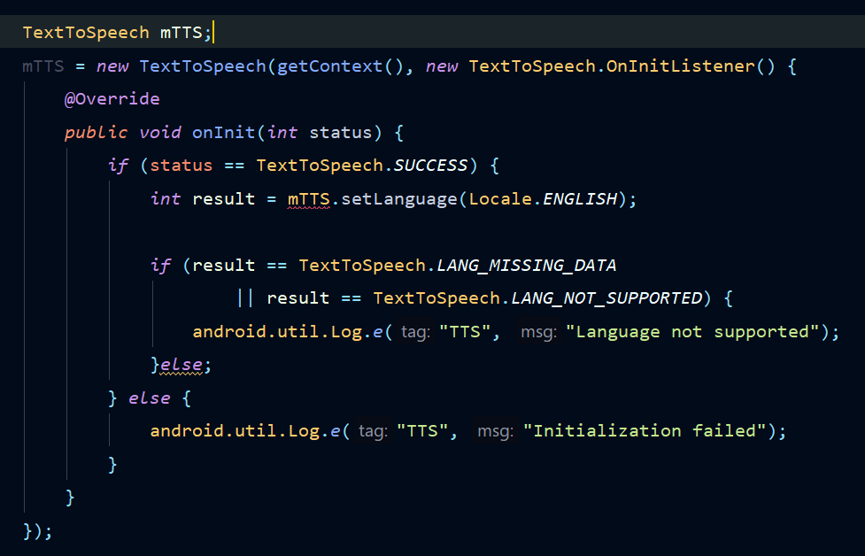
Text To Speech
Android allows you convert your text into voice. Not only you can convert it but it also allows you to speak text in variety of different languages.
Android provides TextToSpeech class for this purpose. In order to use this class, you need to instantiate an object of this class and also specify the initListener. Its syntax is given below.

Slide 47
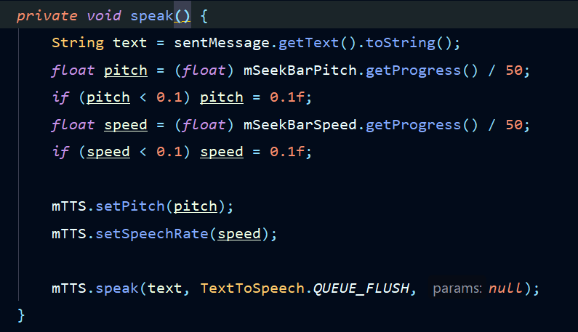
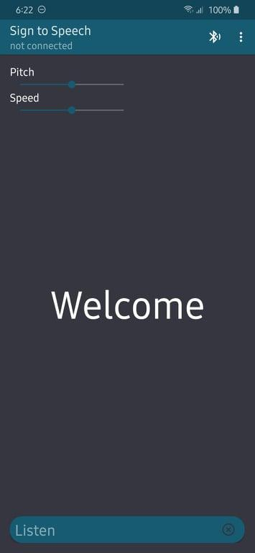
Supported Languages
Language can be set by calling setLanguage() method.
The method setLanguage takes an Locale object as parameter. The list of some of the locales available are :
1.CHINESE
2.ENGLISH
3.FRENCH
4.GERMAN
5.ITALIAN
6.JAPANESE
7.KOREAN
Once you have set the language, you can call speak method of the class to speak the text. We will also adjust the pitch and speed of the spoken text using SeekBars.

Slide 48
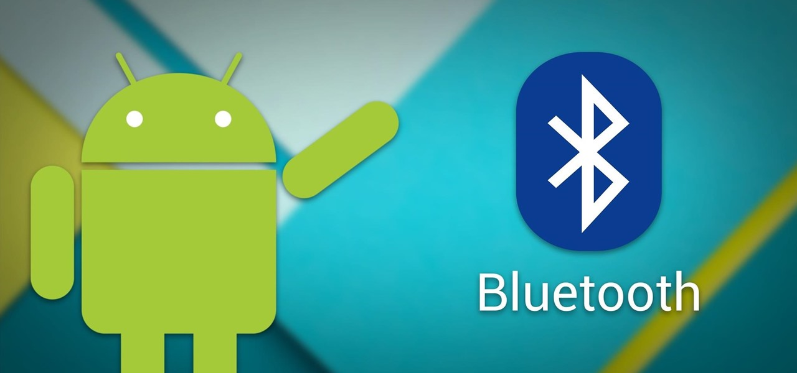
Bluetooth in Android
In order for Bluetooth-enabled devices to transmit data between each other, they must:
form a channel of communication using a pairing process.
One device, a discoverable device, makes itself available for incoming connection requests. Another device finds the discoverable device using a service discovery process. After the discoverable device accepts the pairing request, the two devices complete a bonding process where they exchange security keys. The devices cache these keys for later use.
After the pairing is complete, the two devices exchange information.
When the session is complete, the device that initiated the pairing request releases the channel that had linked it to the discoverable device.
The two devices remain bonded, however, so they can reconnect automatically during a future session as long as they're in range of each other and neither device has removed the bond.

Slide 49
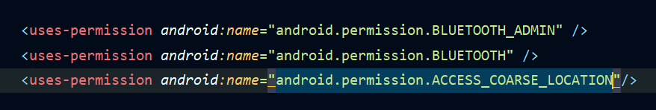
Bluetooth permissions
In order to use Bluetooth features in your application, you must declare permissions.
Declare the Bluetooth permissions in your application manifest file:
BLUETOOTH_ADMIN: To initiate device discovery or manipulate Bluetooth settings.
BLUETOOTH: You need this permission to perform any Bluetooth communication, such as requesting a connection, accepting a connection, and transferring data.
ACCESS_COARSE_LOCATION: Your app needs this permission because a Bluetooth scan can be used to gather information about the location of the user.

Slide 50
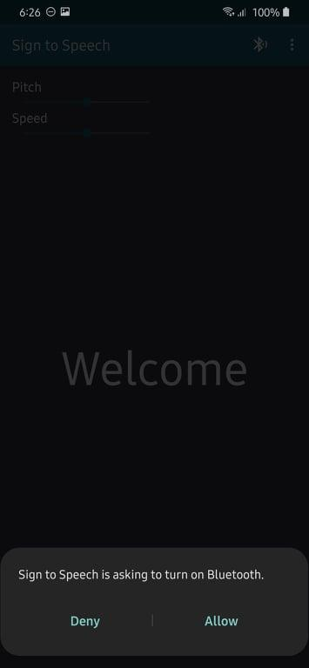
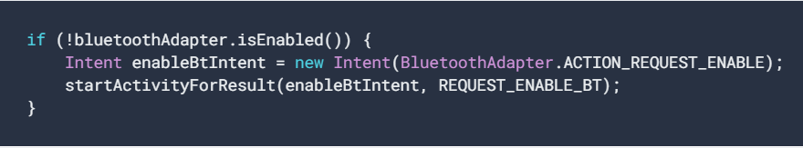
Enable Bluetooth
you need to ensure that Bluetooth is enabled. Call isEnabled() to check whether Bluetooth is currently enabled. If this method returns false, then Bluetooth is disabled.
To request that Bluetooth be enabled, call startActivityForResult(), passing in an ACTION_REQUEST_ENABLE intent action. This call issues a request to enable Bluetooth through the system settings (without stopping your application). For example:
A dialog appears requesting user permission to enable Bluetooth. If the user responds "Allow", the system begins to enable Bluetooth, and focus returns to your application once the process completes (or fails).

Slide 51
Pairing VS Connection
To be paired means that two devices are aware of each other's existence, have a shared link-key that can be used for authentication, and are capable of establishing an encrypted connection with each other.
To be connected means that the devices currently share an RFCOMM channel and are able to transmit data with each other. The current Android Bluetooth APIs require devices to be paired before an RFCOMM connection can be established. Pairing is automatically performed when you initiate an encrypted connection with the Bluetooth APIs.

Slide 52
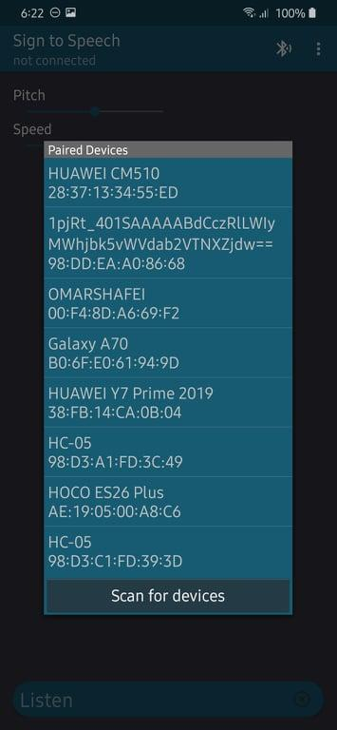
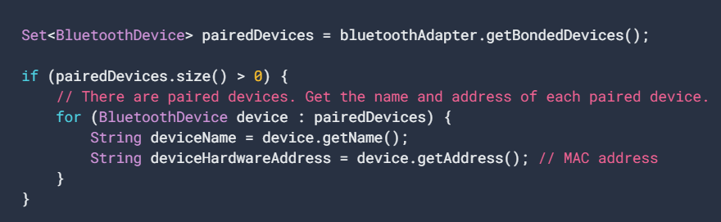
Connect devices
To Display the paired devices: call getBondedDevices(). This returns a set of BluetoothDevice objects and get the name and MAC address of each device:
To initiate a connection with a Bluetooth device, all that's needed from the associated BluetoothDevice object is the MAC address, which you retrieve by calling getAddress().

Slide 53
Manage a connection
After you have successfully connected multiple devices, each one has a connected BluetoothSocket.
This is where the fun begins because you can share information between devices. Using the BluetoothSocket, the general procedure to transfer data is as follows:
Get the InputStream and OutputStream that handle transmissions through the socket using getInputStream() and getOutputStream(), respectively.
Read and write data to the streams using read(byte[]) and write(byte[]).

Slide 54
Displaying the text
So, after receiving the text by Bluetooth, the text is displayed in the center of the screen, and said.

Slide 55
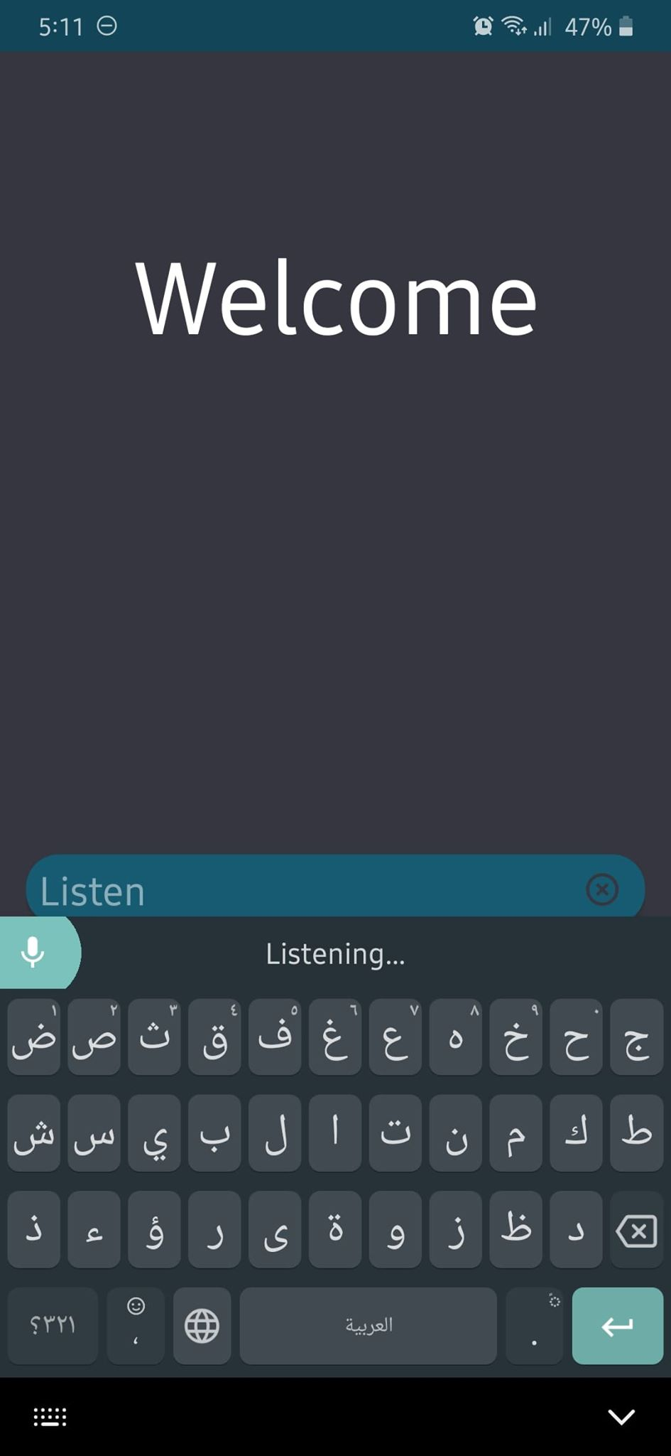
Listening
Now we solved the problem of speaking, but what about listening?
we used an app made by google which is Gboard(Google keyboad).
so how to use it inside our app:
Download the app from Play Store.
Make it the default keyboard for your mobile.
In our app there’s a text field in the bottom of the screen, click inside it to open your keyboard.
Click the record icon and your mobile now listening.
The speech then is converted to text, and is shown inside the text field.
The language you listen is the language selected in the keyboard.

Slide 56
Resources
Mazidi AVR book
ATmega32 Datasheet
https://www.javatpoint.com/java-tutorial
https://www.tutorialspoint.com/android/android_text_to_speech.htm
https://developer.android.com/guide/topics/connectivity/bluetooth
https://github.com/android/connectivity-samples/tree/master/BluetoothChat
https://www.learnhowtoprogram.com/android/introduction-to-android/introduction-to-xml-and-android-layouts
https://play.google.com/store/apps/details?id=com.google.android.inputmethod.latin&hl=en
https://github.com/OmarShafei-coder/SignToSpeech

Slide 57
